Slide 1

Anchored Multiperspective Visualization for Efficient VR Navigation
Meng-Lin Wu and Voicu Popescu
Purdue University

Slide 2
Navigation in VR
Tracked Head-Mounted Displays (HMD)
6 DoF tracking widely available

Slide 3
Navigation in VR
Tracked Head-Mounted Displays (HMD)
6 DoF tracking widely available
Identity mapping – virtual <-> physical
Intuitive
Low motion sickness
High presence

Slide 4
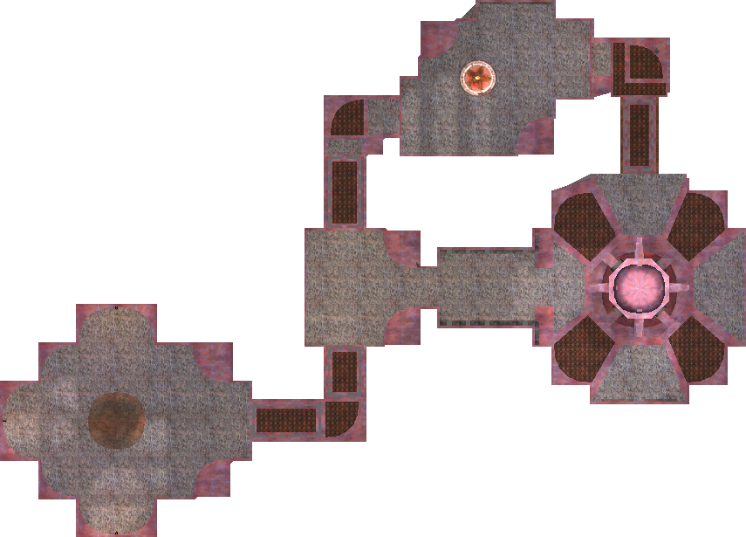
Navigation in VR
Virtual space

Slide 5
Navigation in VR
2m x 2m
Physical space
Virtual space

Slide 6
Navigation in VR
Comfortably
Efficiently
2m x 2m
Physical space
Virtual space

Slide 7
Inefficiency due to occlusions
Inefficiency due to occlusions
Move to gain line of sight
Disjoint regions of interest

Slide 8
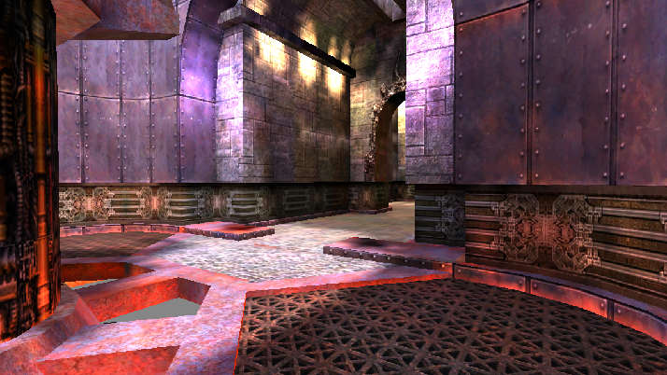
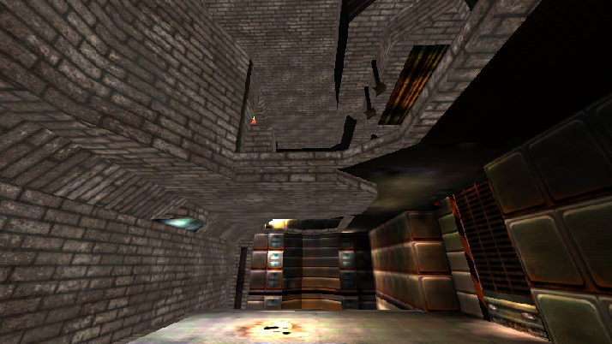
Inefficiency due to occlusions
Inefficiency due to occlusions
Move to gain line of sight
Disjoint regions of interest
Can’t see down side corridor
Can’t see up ledge

Slide 9
Inefficiency due to occlusions
Multiperspective visualization (MPV)

Slide 10
Inefficiency due to occlusions
Multiperspective visualization (MPV)
What
Additional perspectives integrated with primary perspective

Slide 11
Inefficiency due to occlusions
Multiperspective visualization (MPV)
What
Additional perspectives integrated with primary perspective
Why
Primary perspective anchors user
Localize in VR space

Slide 12
Inefficiency due to occlusions
Multiperspective visualization (MPV)
What
Additional perspectives integrated with primary perspective
Why
Primary perspective anchors user
Localize in VR space
Secondary perspective previews destinations
Less wasted locomotion (improved efficiency)

Slide 13
Inefficiency due to occlusions
Multiperspective visualization (MPV)
What
Additional perspectives integrated with primary perspective
Why
Primary perspective anchors user
Localize in VR space
Secondary perspective previews destinations
Less wasted locomotion (improved efficiency)
How

Slide 14
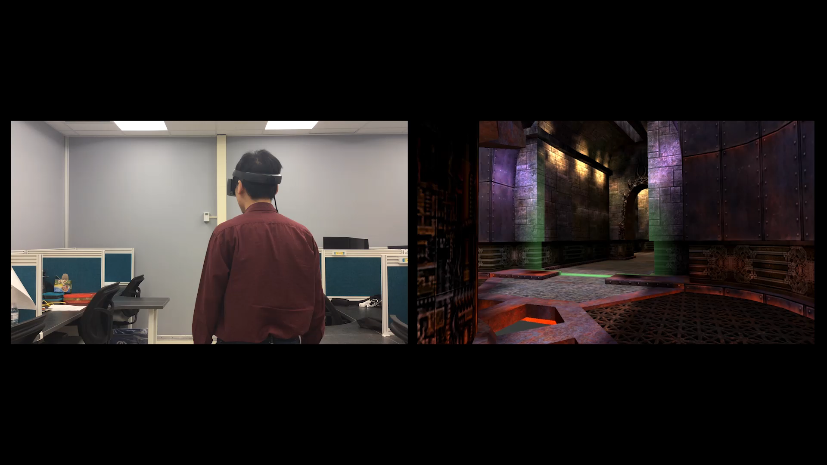
MPV for lateral disocclusion

Slide 15
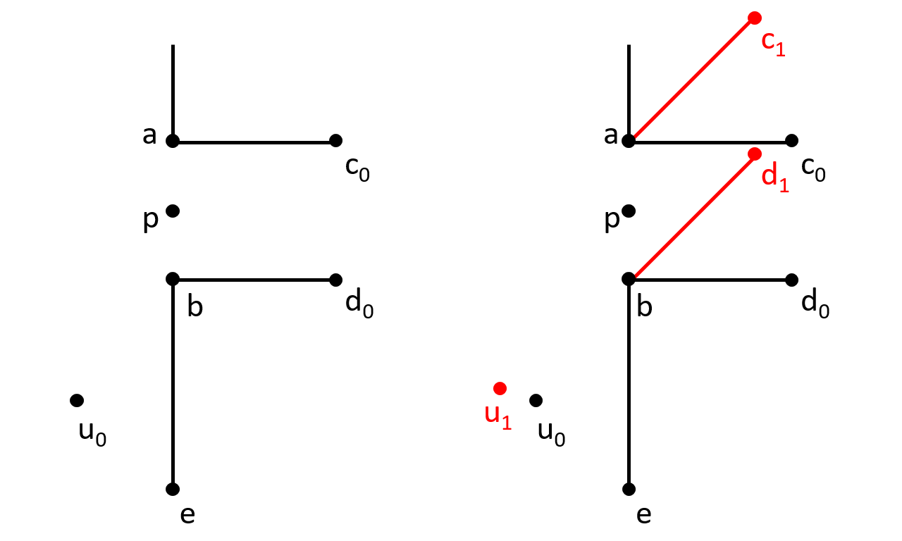
MPV for lateral disocclusion
Top view
Main perspective
Main + secondary perspective

Slide 16
MPV for lateral disocclusion
Top view
Main perspective
Main + secondary perspective

Slide 17
MPV for lateral disocclusion
Top view
Intuitive UI?
Main perspective
Main + secondary perspective

Slide 18
MPV for lateral disocclusion
Top view
Intuitive UI?
Main perspective
Main + secondary perspective

Slide 19
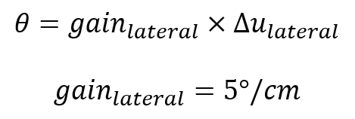
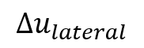
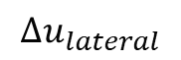

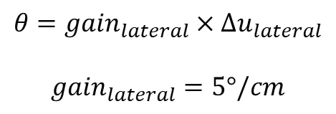

MPV for lateral disocclusion
Top view
$$θ$$
Intuitive UI?
$$θ={gain}_{lateral}×Δu_{lateral}$$
$${gain}_{lateral}=5°/cm$$
$$θ$$
$$Δu_{lateral}$$
Main perspective
Main + secondary perspective

Slide 20
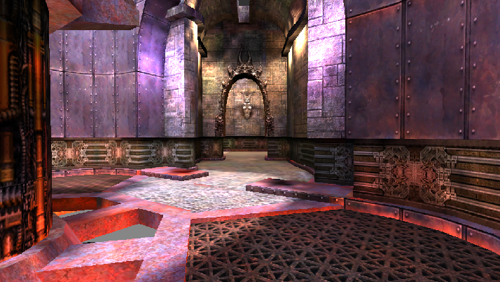
MPV for lateral disocclusion
Main perspective
Main + secondary perspective

Slide 21
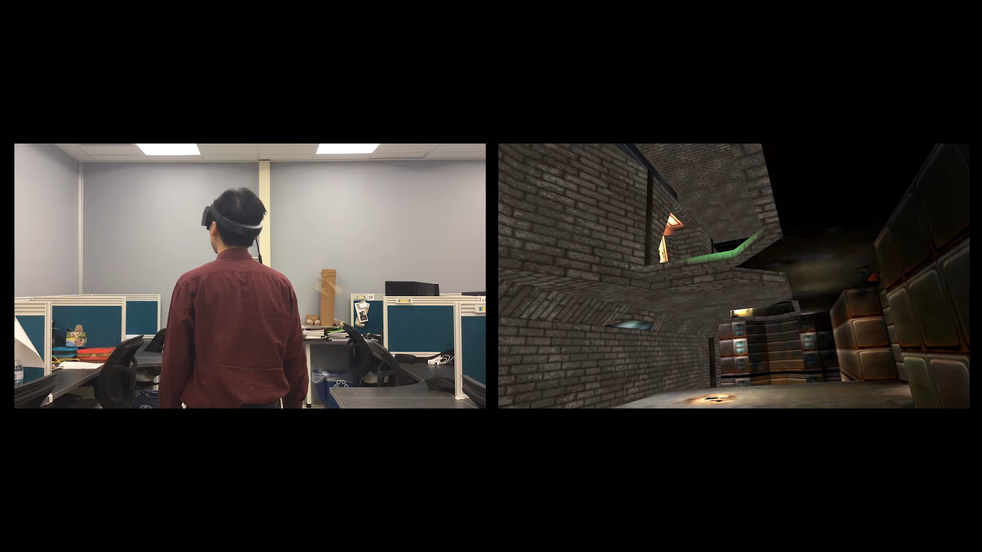
MPV for vertical disocclusion

Slide 22
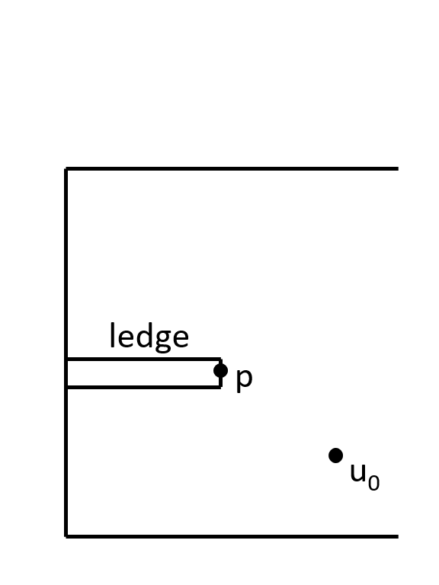
MPV for vertical disocclusion
Side view
Main perspective

Slide 23
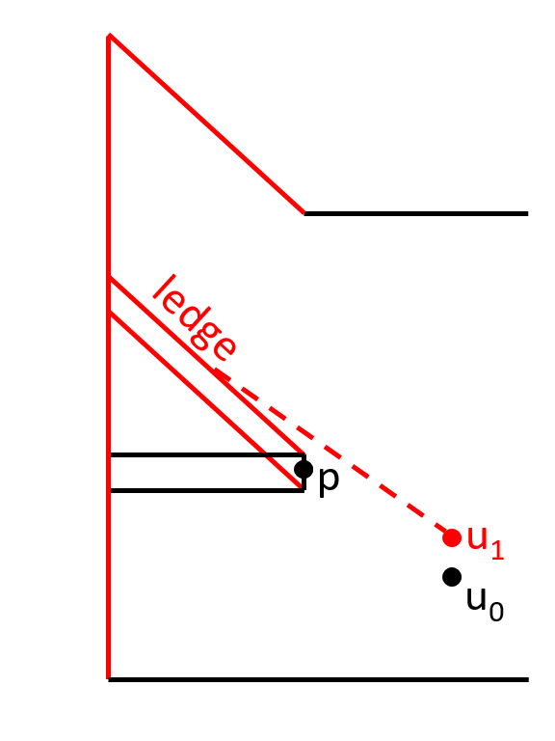
MPV for vertical disocclusion
Side view
Main perspective
Main + secondary perspective

Slide 24
MPV for vertical disocclusion
Side view
Intuitive UI?
Main perspective
Main + secondary perspective

Slide 25
MPV for vertical disocclusion
Side view
Intuitive UI?
Main perspective
Main + secondary perspective

Slide 26
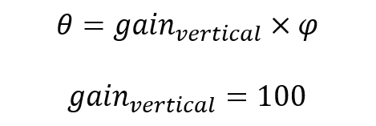
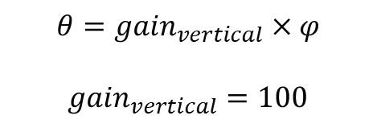


MPV for vertical disocclusion
Side view
Intuitive UI?
$$θ={gain}_{vertical}×φ$$
${gain}_{vertical}=100$
$$θ$$
$$φ$$
Main perspective
Main + secondary perspective

Slide 27
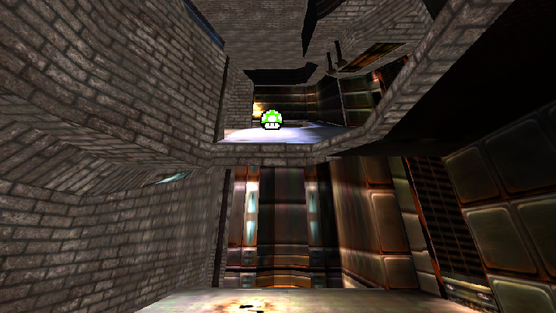
MPV for vertical disocclusion
Main perspective
Main + secondary perspective

Slide 28
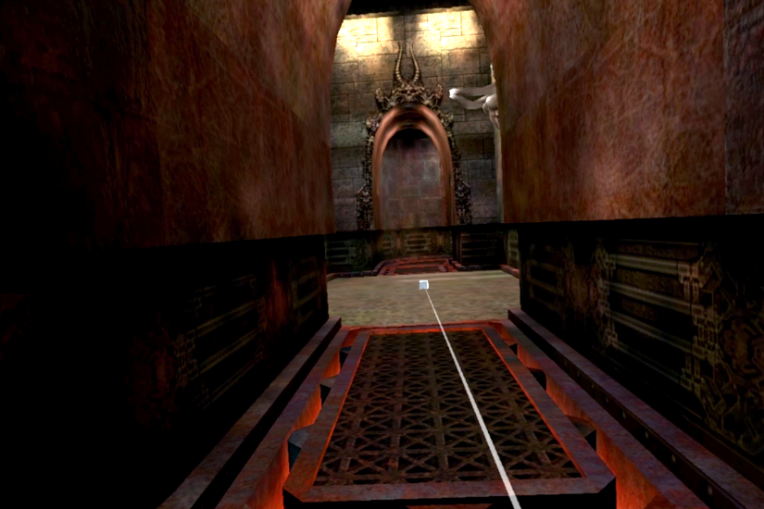
Can we improve teleportation?
Disrupted visualization
Disrupted localization
2m x 2m
Physical space
Virtual space

Slide 29
Can we improve teleportation?
What is better teleportation?
Fewer teleportations
Less disruption

Slide 30
Can we improve teleportation?
What is better teleportation?
Fewer teleportations
Less disruption
I. is achieved with MPV disocclusion
Previews ROI – Reduces unnecessary teleportation
Brings destinations into vista space – Simplifies necessary teleportations

Slide 31
Can we improve teleportation?
What is better teleportation?
Fewer teleportations
Less disruption
I. is achieved with MPV disocclusion
Previews ROI – Reduces unnecessary teleportation
Brings destinations into vista space – Simplifies necessary teleportations
How to achieve II.?

Slide 32
Can we improve teleportation?
What is better teleportation?
Fewer teleportations
Less disruption
I. is achieved with MPV disocclusion
Previews ROI – Reduces unnecessary teleportation
Brings destinations into vista space – Simplifies necessary teleportations
How to achieve II.?
Anchored teleportation

Slide 33
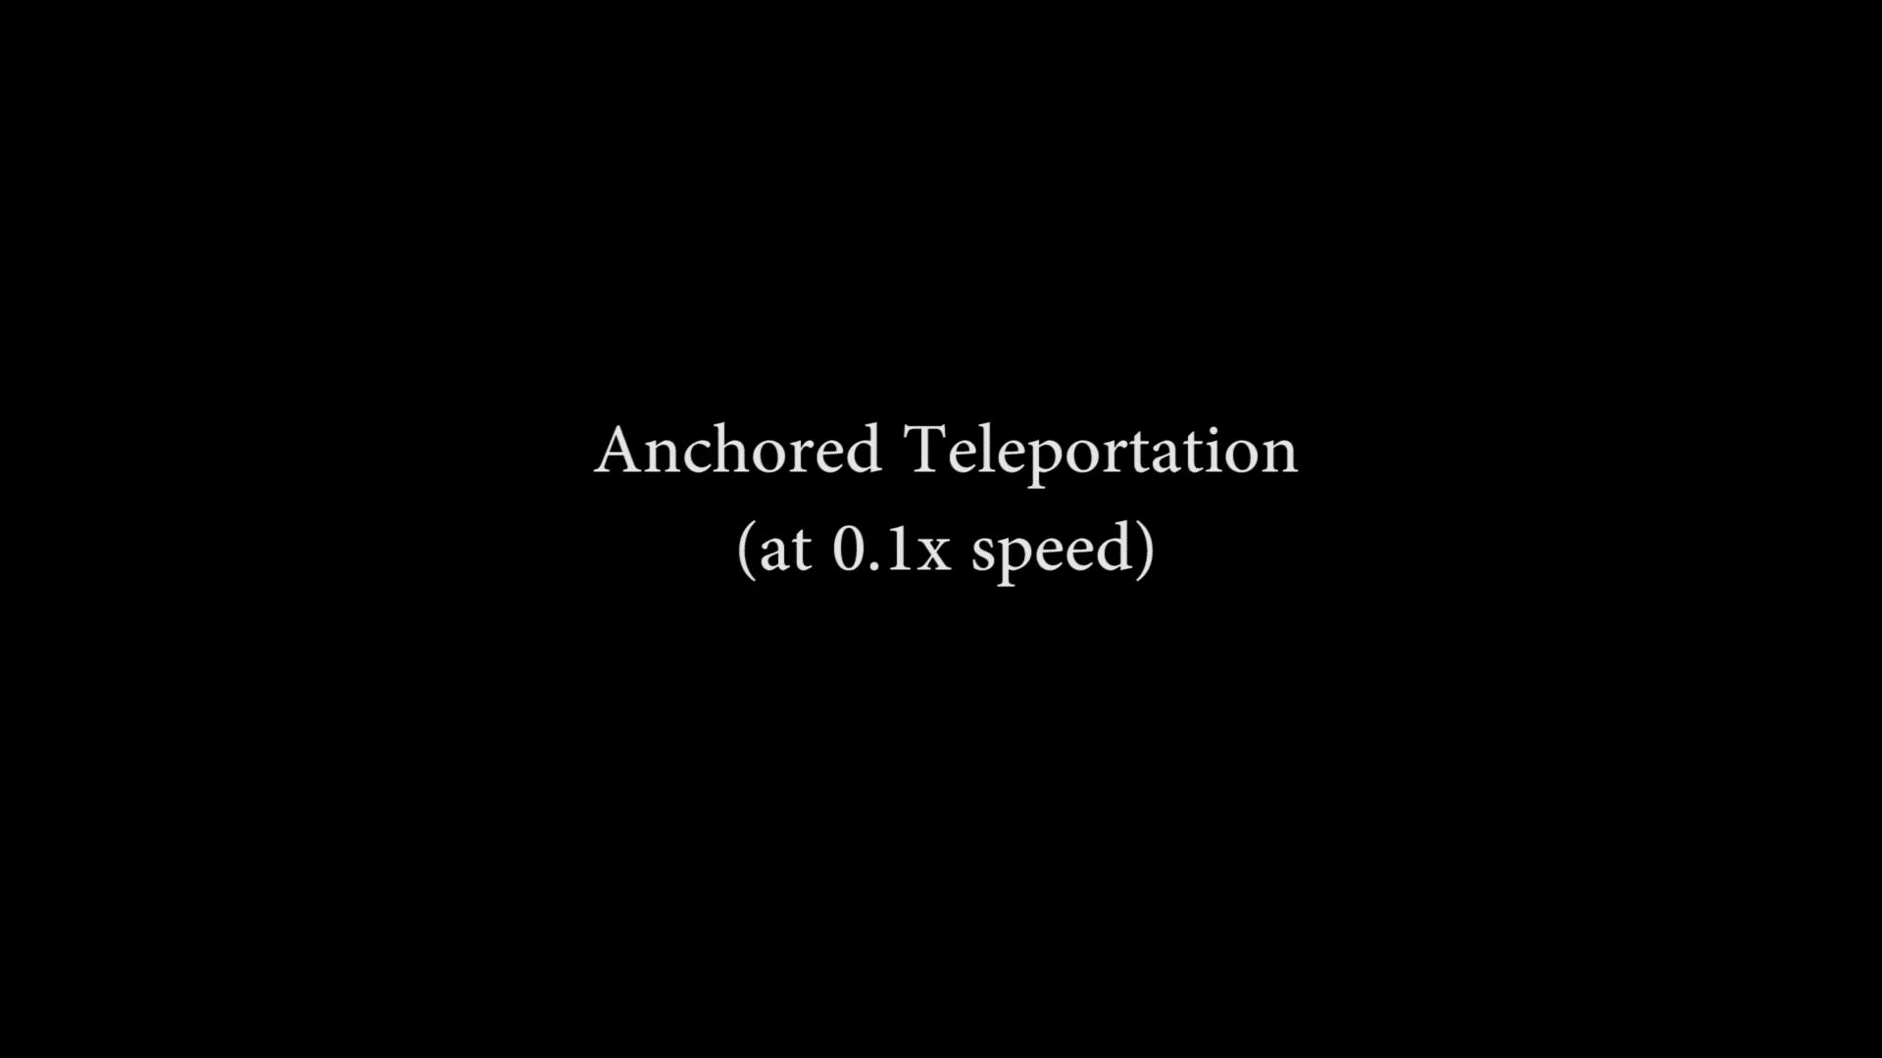
MPV for anchored teleportation

Slide 34
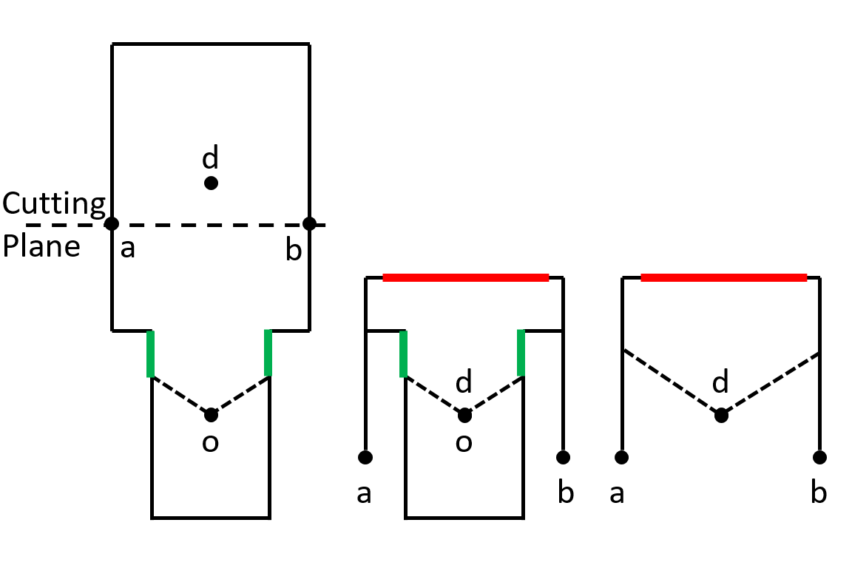
MPV for anchored teleportation

Slide 35
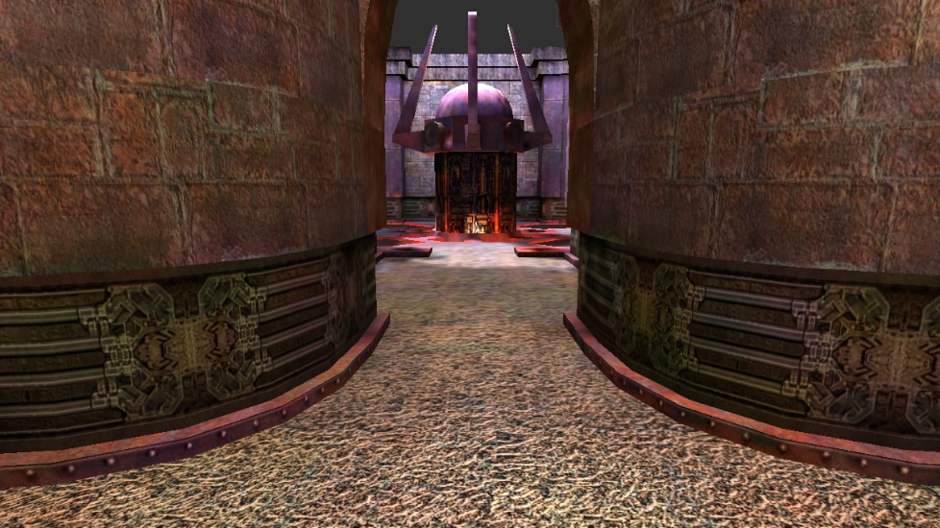
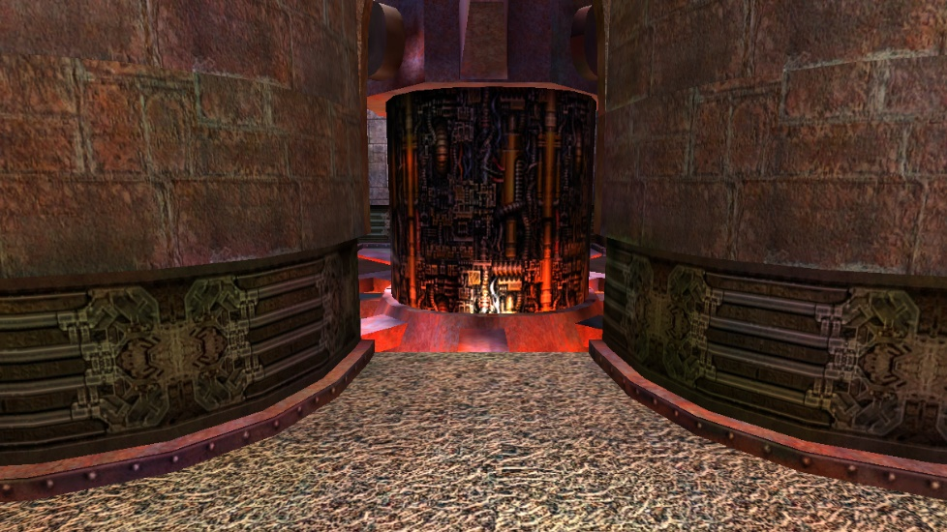
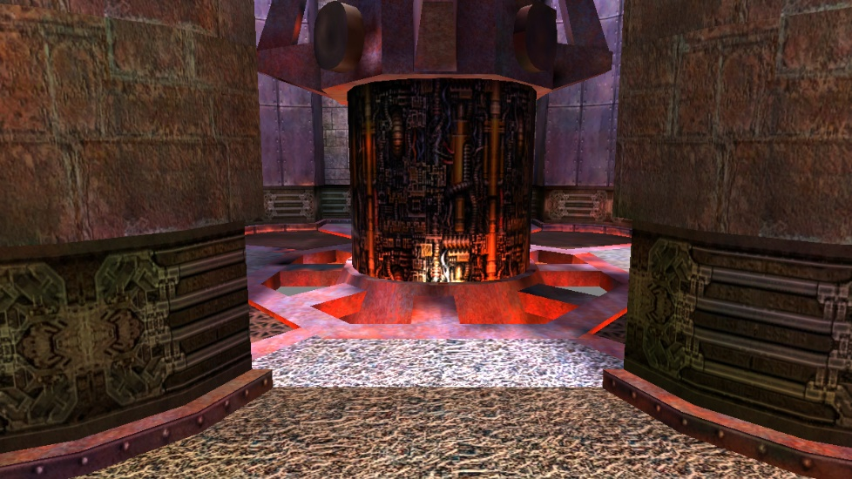
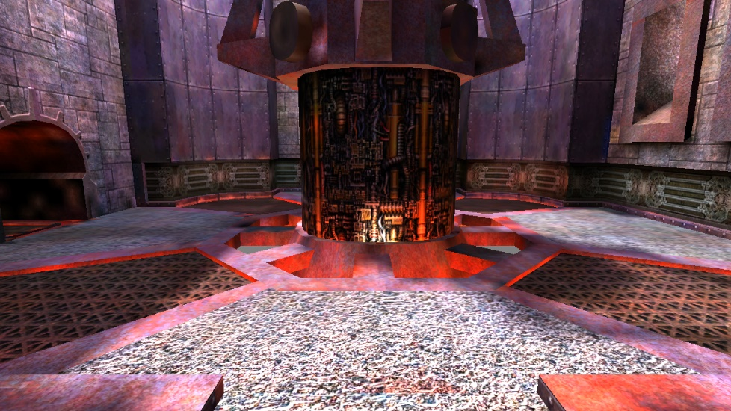
MPV for anchored teleportation
User wearing AR HMD

Slide 36
MPV achieves…
Anchored lateral / vertical disocclusion
Anchored scene exploration
Preview ROIs
Bring potential destinations into vista space
Anchored teleportation
Visualization is continuous
Anchored in at least one space

Slide 37
MPV achieves…
Anchored lateral / vertical disocclusion
Anchored scene exploration
Preview ROIs
Bring potential destinations into vista space
Anchored teleportation
Visualization is continuous
Anchored in at least one space
Validate claims by user study

Slide 38
User study
16 participants
Control vs experiment
Searching and matching tasks
Searching for objects
Matching pairs of identical objects
Metrics
Number of teleportations
Distance traveled
Task completion time

Slide 39




User study
Searching task
Collect scattered gold coins
Matching task
Mark identical mushrooms
≠
=

Slide 40


User study
Search 1: x6
Match: = x4
2m x 2m
Physical space
Scene 1

Slide 41
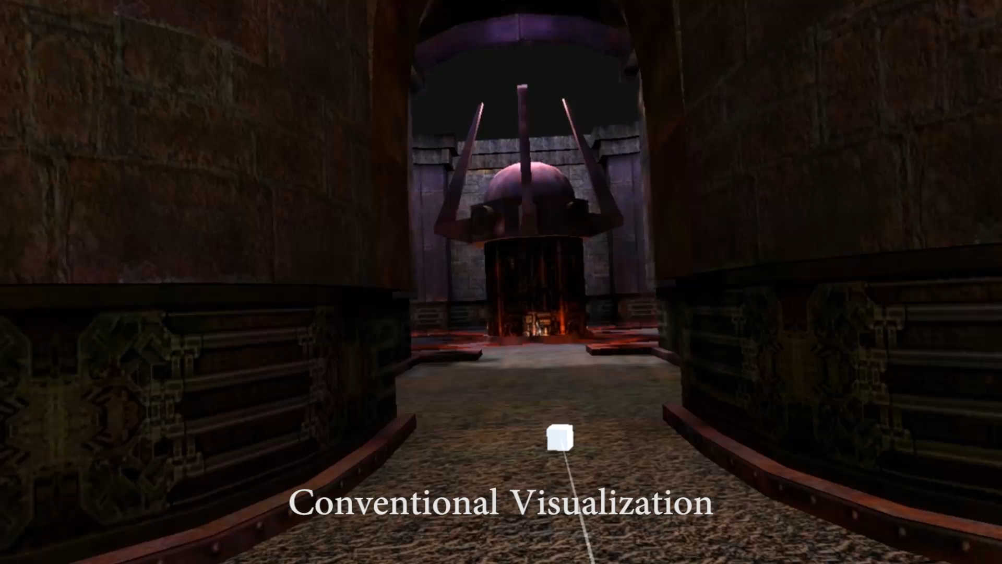
User study
Search 1: x6

Slide 42
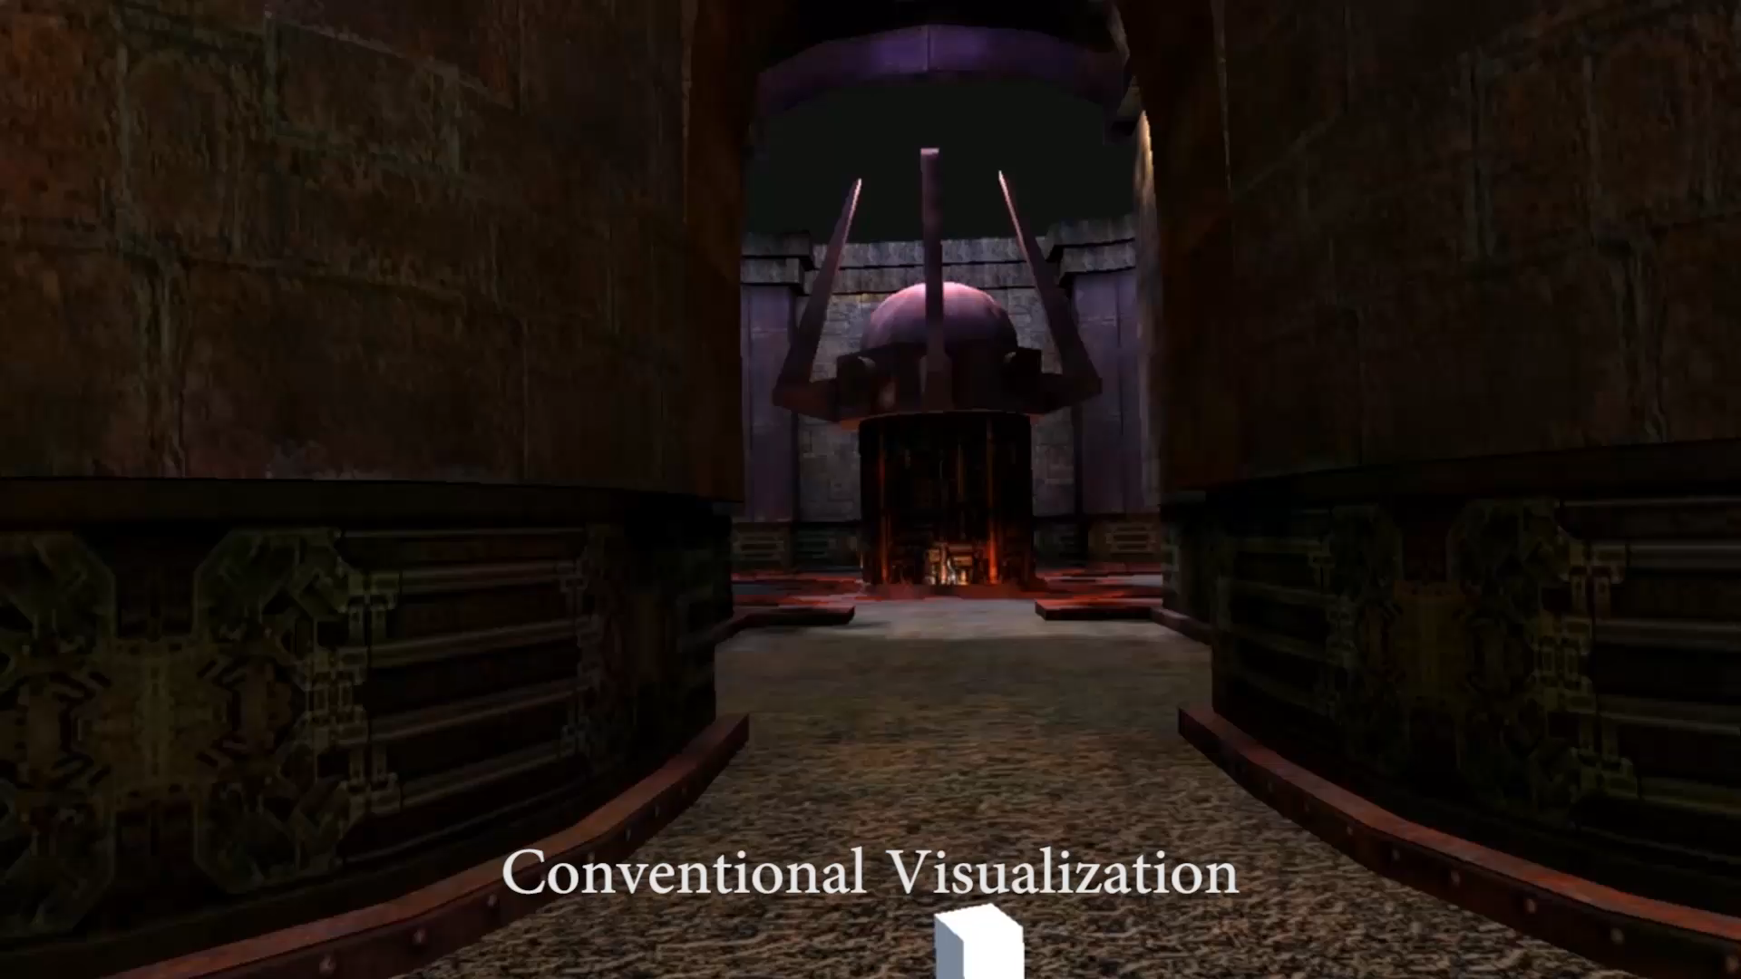
User study
Match: = x4

Slide 43
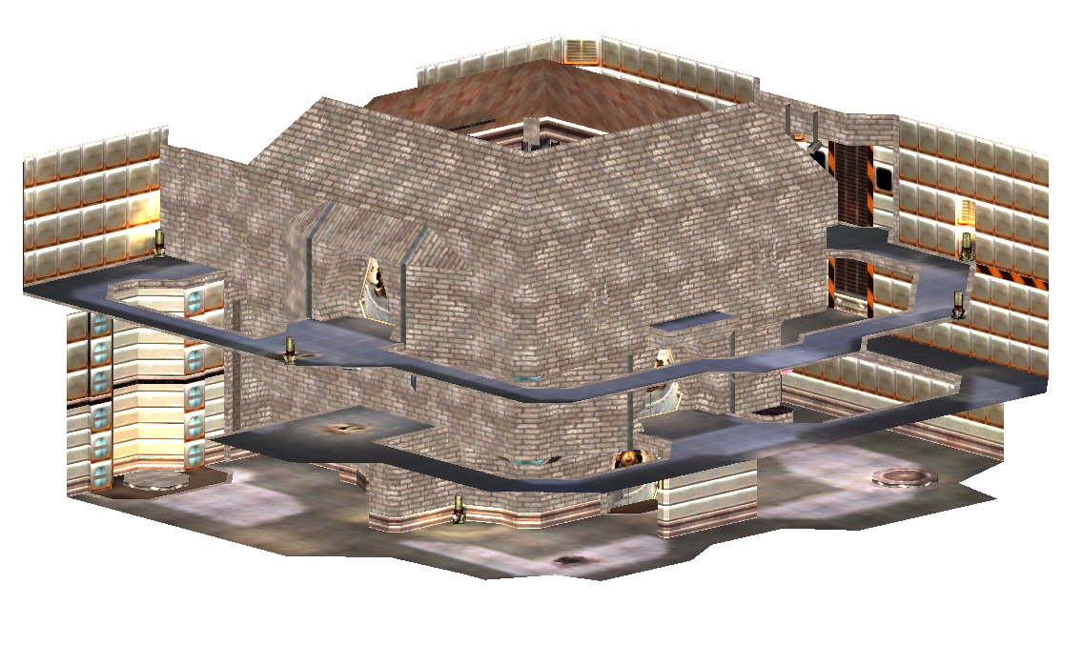
User study
Search 2: x6
2m x 2m
Physical space
Scene 2

Slide 44
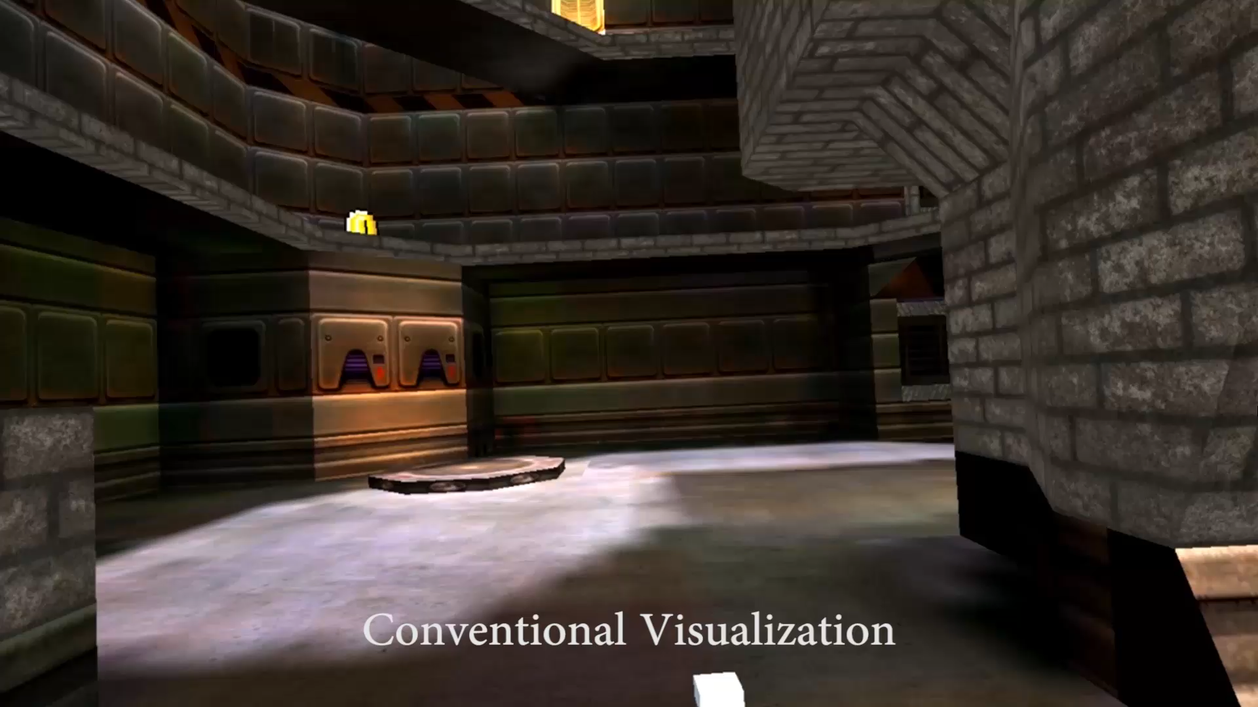
User study
Search 2: x6

Slide 45
User study
Efficiency metrics
Number of teleportations
Distance traveled
Task completion time

Slide 46


MPV reduces number of teleportatoins
Number of teleportations per participant
Task | Control | Experiment | Difference | p | d | Effect size
Search 1 | 83.4 ± 48.9 | 21.6 ± 18.5 | 61.8 | < 0.01 | 1.7 | very large
Match | 51.8 ± 24.8 | 27.6 ± 22.7 | 24.1 | 0.03 | 1.0 | large
Search 2 | 98.3 ± 71.5 | 50.3 ± 31.5 | 48.0 | 0.06 | 0.9 | medium

Slide 47
MPV reduces distance traveled
Distance traveled per participant, in meters
Task | Control | Experiment | Difference | p | d | Effect size
Search 1 | 464 ± 135 | 222 ± 90 | 242 | < 0.01 | 2.1 | huge
Match | 326 ± 103 | 228 ± 86 | 99 | 0.03 | 1.0 | large
Search 2 | 677 ± 306 | 527 ± 236 | 150 | 0.1 | 0.5 | medium

Slide 48
MPV reduces time
Completion time, in seconds
Task | Control | Experiment | Difference | p | d | Effect size
Search 1 | 113 ± 45 | 56 ± 29 | 57 | < 0.01 | 1.5 | very large
Match | 89 ± 25 | 78 ± 25 | 11 | 0.2 | 0.4 | small
Search 2 | 157 ± 71 | 175 ± 88 | (18) | 0.7 | 0.2 | small

Slide 49
Results
Efficiency metrics
Number of teleportations
Distance traveled
Task completion time
Improvement in all metrics
Except task completion time in Search 2

Slide 50
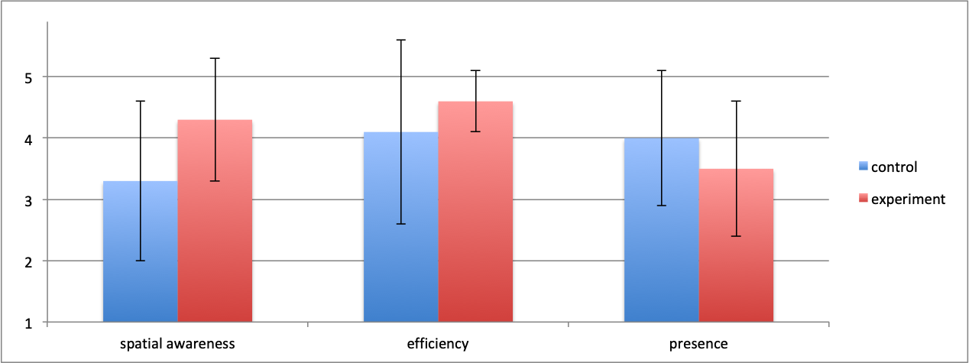
Subjective evaluation of MPV
Spatial awareness: “Your spatial awareness was maintained while moving around”
Efficiency: “You could reach any intended destination efficiently”
Presence: “You always felt present in the virtual world”
Strongly agree
Neutral
Strongly disagree

Slide 51
Subjective evaluation of MPV
Better spatial awareness and efficiency
Worse presence
No complaints about motion sickness

Slide 52
Conclusions
MPV for disocclusion
Always anchors the user
Previews potential ROIs
Avoids unnecessary teleportation
MPV for teleportation
Always anchors the user
Brings potential destinations into vista space
Improves spatial awareness

Slide 53
Future work
MPV implementation
Automatic portal placement
Ray-traced rendering
Other than teleportation?
Joystick, keyboard & mouse, treadmill
Redirected walking
Other applications
Even more limited space – sitting at desk
Games

